Slide 1
Parser & Code Generation:
A close look at Constant and If mechanics

Slide 2
Project Overview
Compiler Front End
  Scanner (assignment 2): Reads the source code written by users and creates tokens. The scanner should find syntax errors in the code.
Compiler Mid Section
  Parser and code generator(assignment 3): Parses the tokens, creates a symbol table and emits intermediate code.
Compiler Back End:
  Virtual Machine (assignment 1): Reads the intermediate code and runs the program to completion.

Slide 3
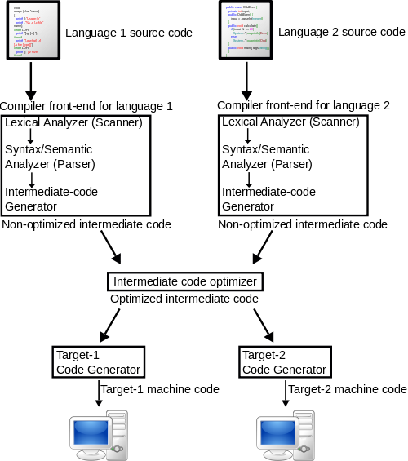
Project Overview cont.
Notes:
http://upload.wikimedia.org/wikipedia/commons/thumb/6/6b/Compiler.svg/500px-Compiler.svg.png

Slide 4
Source code example of constant
Block {
…
if (token->tokenType == constsym){
do{
token = getNextToken(token);
if (token->tokenType == identsym){
makeSymbol (token, constsym, 0); //m value made in function, value of const
token = getNextToken(token);
if (token->tokenType == eqsym){
token = getNextToken(token);
if (token->tokenType == numbersym){
token = getNextToken(token); //M value already produced
}
else
error(2);
}
else
error(3);
}
else
error(4);
}while (token->tokenType == commasym);
…

Slide 5
Constant cont.
makeSymbol{
if (num == constsym){
symTable[tCount].kind = 1 ;
strcpy(symTable[tCount].name , ptr->token) ;
symTable[tCount].level = global;
symTable[tCount].val = convert(ptr->next- >next->token) ; //Add the m value for lit
}

Slide 6
Constant
Constants are declared in the block of a program.
Constants can be used in an expression or any other place where a number could be used
So a constant is:
Factor{
//Emit code if factor is const
if (getKind(token) == 1){
emit(LIT, getLevel(token), getVal(token)) ;
}

Slide 7
Source code example of if
Statement{
…
else if (token->tokenType == ifsym){
token = getNextToken(token);
token = condition(token);
if (token->tokenType != thensym)
error(16);
else {
token = getNextToken(token);
int tempCX = cx ; //Save the current position of the codeStack
emit(JPC, 0, 0) ; //Emit a JPC command and save the m value later when we know where the then block ends
token = statement(token);
if(token->tokenType == elsesym){
int JMPvar = cx;
emit(JMP, 0, 0) ;
codeStack[tempCX].m = cx ; //Now the JPC.m can be handled because the if-then is complete
token = getNextToken(token);
token = statement(token);
codeStack[JMPvar].m = cx ; //If then executes we will jump over the else
}
else //There is no else
codeStack[tempCX].m = cx ;
}
}

Slide 8
If explained
A call to if is followed by a condition. The condition function will push a zero or one on the stack for the JPC to evaluate.
The JPC will jump past the if or will fail, so the if-then can execute
When else exists an if must end in a JMP that skips the execution on the else.
  JPC Should jump to the line after this mentioned JMP

